Slide 1



Welcome to the

Slide 2
Mental Health Carer Forum Agenda
9:00am Registration (Tea & Coffee available) | 12:15pm Lunch with Exhibitors
9:30am Session 1 | 1:00pm Session 3
Welcome to Country | Somatic Movement Exercise
Welcome & Opening Introduction | Consultation Activity with Carers Guided Meditation Session
Connection Activity Introduction of Guest Speakers; | Forum Wrap Up Survey, Feedback & Lucky Door Prizes
Question & Answer Session
11:00am Morning Tea with Exhibitors | 3:00pm Forum End; Afternoon Tea with Exhibitors
11:30am Session 2
Panel Discussion with Local Supporters
Question & Answer Session

Slide 3
Mental Health Carer Forum
Welcome to Country
Gimuy Walubara Yidinji Elders

Slide 4

Mental Health Carer Forum
Welcome
Emma Griffiths, Senior Advisor – Policy & Advocacy

Slide 5
Mental Health Carer Forum
Connection Activity
Getting to know you

Slide 6

Mental Health Carer Forum
Welcome
Irene Clelland, CEO Arafmi

Slide 7



Mental Health Carer Forum
Please welcome
Ivan Frkovic
Queensland Mental Health Commissioner
Katrina Armstrong
Executive Officer, Mental Health Carers Australia
Simon Katterl
CEO, Mental Health Lived Experience Peak Queensland

Slide 8
Mental Health Carer Forum
Questions & Answers
Ivan
Katrina
Simon

Slide 9
Mental Health Carer Forum
Morning Tea
Session 2 starts at 11:30am

Slide 10
Mental Health Carer Forum
Session 2
Panel discussion with local supporters

Slide 11
Carer Gateway
Connecting carers with local supports

Slide 13

Overview for today:
Who is a carer
What is Carer Gateway
Types of services and supports available to carers
The Carer Gateway registration process

Slide 14
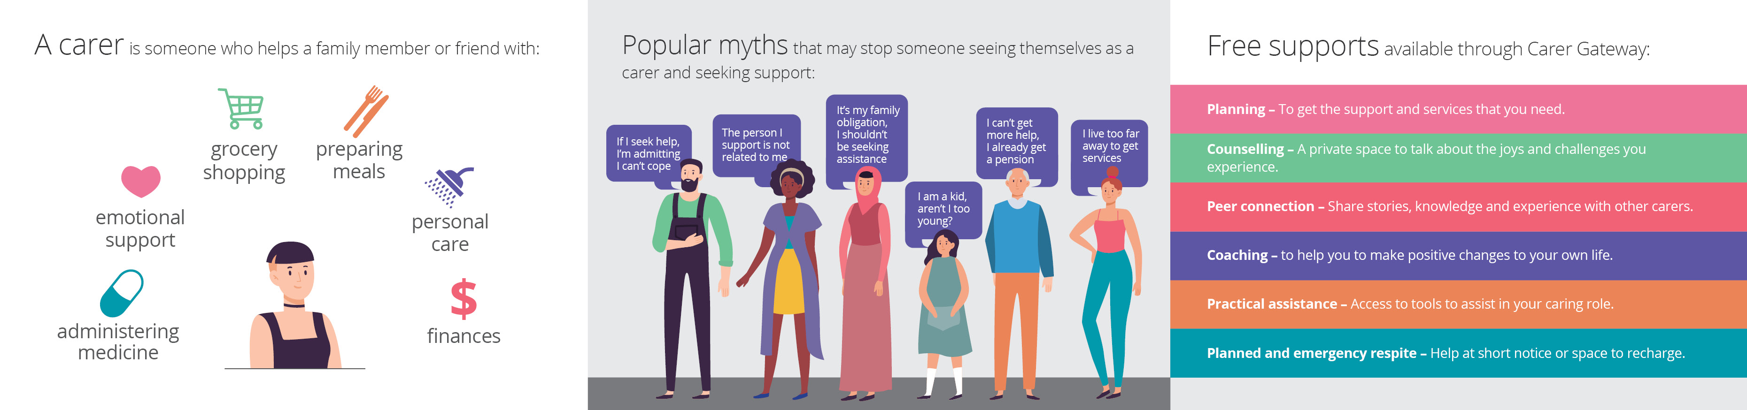
A carer is someone who helps a family member or friend with …
Notes:
Many people don’t see themselves as a carer – just a mum, dad, sister, son, spouse or friend – but anybody can be a carer at any time, and any age.
Not all caring looks the same. Some carers provide care all the time, while some only provide care occasionally. Some carers may share their caring responsibilities with a family member or another person close to them.
No matter what your caring role looks like, Carer Gateway is here to help.

Slide 15
Popular myths that may stop someone seeing themselves as a carer and seeking support:

Slide 16

What is Carer Gateway?
Carer Gateway is an Australian Government initiative connecting unpaid carers with local services and supports.
Notes:
Funded by Department of Health, Disability and Ageing

Slide 17
Who delivers
Carer Gateway services in my area?

Slide 18


Wellways
Carer Gateway
Vocational Pathway Program

Slide 20

A tailored employment support program for carers
Helps carers explore, prepare for and transition into study, work or volunteering
1:1 and group support with a Vocational Navigator
Completely voluntary and flexible
Delivered under Carer Gateway independently or alongside other supports carers might be accessing
Meets carers where they’re at – emotionally, practically and geographically
Notes:
Returning to work or looking to enter the workforce can provide carers with enormous purpose, self-confidence and financial independence.
Similarly to the previous ‘Your Caring Way’ program, our new Vocational Pathway / Coaching support program is designed for carers and delivered by our Vocational Navigator teams across QLD.
We’re supporting carers to build confidence in obtaining employment, volunteering work or study.

Slide 21
The Need is clear:
Vocational Pathway Program aims to:
Promote empowerment, not just support
Improve long-term wellbeing
Help break cycles of disadvantage
Connect carers to meaningful pathways
Notes:
Vocational Pathway Program aims to:
Promote empowerment, not just support
Over 50% of carers feel they lack time for themselves and have more responsibility than they can manage. Employment can provide purpose, financial stability, and social connection.
Improve long-term wellbeing
Employed carers are more than 15% more likely to report better wellbeing. Supporting carers into employment or training can reduce isolation, distress, and financial stress.
Help break cycles of disadvantage
Nearly 1 in 6 carers live in poverty, and over 60% experienced major financial stress in the past year. Promoting work and study helps address social determinants of health.
Connect carers to meaningful pathways
Carers often feel forgotten or excluded. Encouraging employment and study builds confidence, identity, and hope beyond the caring role.
These statistics from the 2023 Carer Wellbeing Survey illustrate the daily reality faced by unpaid carers.
The data makes it very clear that carers face significant disadvantages in health, financial wellbeing, and access to employment or education.
This is why programs like the Vocational Pathway Program are not just valuable—they are essential. We meet carers where they’re at and help them take meaningful steps toward paid work, study, or training

Slide 22
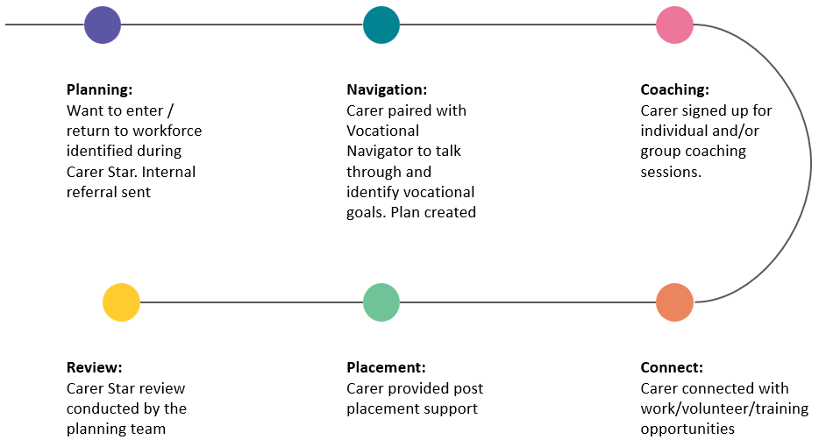
The Vocational Navigation Journey

Slide 23
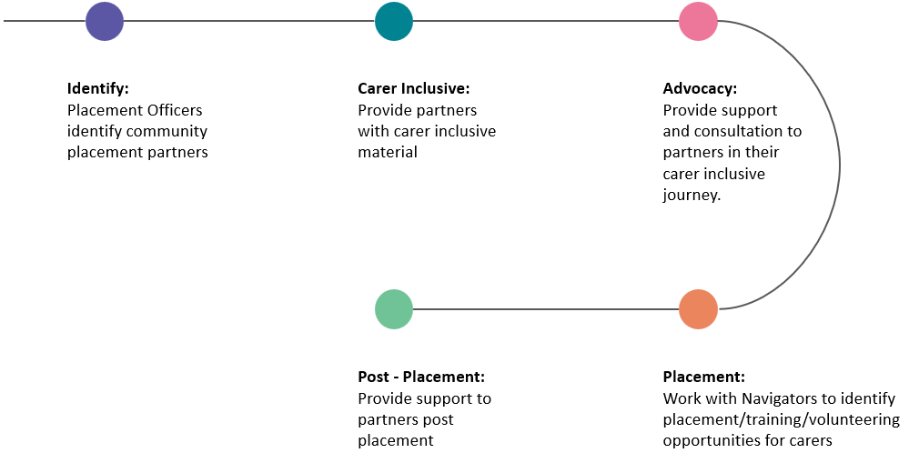
The Placement Journey

Slide 24
What's in the coaching sessions?

Slide 25
Exploring returning to work program
Focuses on helping carers to identify their skills and interests, explore potential career options and address any barriers to employment.
Week One: Understanding your unique strengths as a carer.
Week Two: Exploring career options and pathways.
Week Three: Overcoming barriers and building confidence.
Week Four: Taking the next steps - action planning and ongoing support.
Notes:
This program is designed for carers who are in the early stages of considering returning to the workforce or entering it for the first time.
The program comprises of four weeks of guided discovery, with the goal to help carers identify their strengths and the opportunities that are available to them.

Slide 26
I’m Ready for Work Program
Focuses on helping carers to know what to expect when finding a job, attending interviews, receiving an offer of employment, and strategies to ensure a rewarding workplace.
Week 1: Unlocking your potential: Identifying Transferrable Skills and Building Confidence.
Week 2: Presenting your best self: Resumes, cover letters and compliance.
Week 3: Mastering the job search: Interview skills, presentation and technology.
Week 4: Securing Your Future: Job offers, negotiations and workplace success.
Notes:
This program is designed for carers who have made the decision to return to the workforce or enter it for the first time.
The program comprises of four weeks of guided discovery, with the goal to prepare carers for their next job!

Slide 27
Optional group coaching sessions
Effective Resume Writing
Financial Supports and Benefits
Getting the Balance Right
Interview Techniques
Managing at Home
Managing Transitions
Presentation Tips
Social Connections and Support
Notes:
These sessions are optional coaching sessions available for Carers and their Navigator to select for any further learning or supports required.
Conducted in Group or 1:1 settings.

Slide 28


The placement team
Collaborative Journey
Post‑Placement Support
Building a Carer‑Inclusive Network www.carerinclusive.com.au
Notes:
Collaborative Journey
Working closely with Carers and Navigators, assisting to identify suitable:
Employment opportunities,
Training pathways through RTOs,
Volunteering options.
Post‑Placement Support
Offer ongoing check‑ins with both Carer and Host organisation,
Troubleshoot challenges, reinforce supports, celebrate successes.
Building a Carer‑Inclusive Network – www.carerinclusive.com.au
Identify potential Community, Employer, and Training‑Provider partners,
Educate and onboard them on what it means to be ‘Carer Inclusive’,
We are closely aligned with the Carer Inclusive Workplace initiative which is a national collaboration between the Australian Government and Carers Australia, launched as part of wider moves following the Jobs and Skills Summit to support the estimated 3 million unpaid carers in Australia
The Carer Inclusive Workplace Initiative gives community organisations a framework to refer, advocate, and partner, helping carers transition through tailored employment and education supports.
Purpose:
To dismantle barriers carers face in entering and remaining in the workforce.
To promote carer inclusive workplaces by equipping employers and organisations with tools, resources, and practical guidance on supporting employees with caring responsibilities.
Key Features which we will work organisations on:
A free 11 question self‑assessment tool for organisations to evaluate their level of carer inclusivity, receive feedback, and access tailored resources,
A suite of free e‑learning modules for HR professionals and managers, co-designed with carers to build awareness and practical skills in creating inclusive workplaces.
Ready to use resources, including template policies, flexible work examples, and job crafting tools designed by HR experts in consultation with carers
Alignment with Our Vocational Pathway Program:
Both initiatives emphasise strengths-based support and improving carer access to meaningful work.
Carer Inclusive Workplace Initiative focuses on the employer side, enabling workplaces to become more accessible and supportive.
Our Vocational Pathway Program helps carers build confidence, skills, and pathways to work, complementing Carer Inclusive Workplace Initiative by preparing carers to thrive in these inclusive environments

Slide 29

Funding for carers
We can assist with various items including:
Interview and work clothing, incl PPE
Course fee assistance (small amount)
Police Checks / Blue & Yellow Cards / License fees
Digital access
Notes:
The Vocational Pathway Team have limited funding for Carers to assist them with achieving their goals if financial support is needed. Approved on Case-by-Case basis - evidenced.
However, with this limited funding, we can assist with various items including:
Interview and work clothing, incl PPE,
Course fee assistance (small amount),
Police Checks / Blue & Yellow Cards / License fees,
Digital access.

Slide 30
Who are we?
Vocational Navigators:
Mark Kimmorley
Vocational Pathway Lead
Kate Mulvaney
Vocational Navigation Coordinator
Upper Mount Gravatt | Dami Korte
Gold Coast | Lisa Cooper
Ipswich | Samantha Caves
Toowoomba | Samantha Dempsey
Bundaberg | Lionel Evans
Maroochydore | Varsha Chowdury
Nambour | Marcus Priaulx
Cairns | Rosalie Basso
Gladstone | Lauren Schneider
Upper Mount Gravatt | Nitesh Makan (Vocational Placement Officer)
Bundaberg | Anne Richardson (Vocational Placement Officer)

Slide 31
How you can help carers thrive
Refer a carer to the program
Partner with us
Spread the word in your community
Connect us with your networks
To connect with us call 1800 422 737.
Notes:
Refer a carer to the program
Partner with us to offer flexible employment, training and volunteering opportunities,
Spread the word in your community,
Connect us to carers’ networks or community organisations
How to refer
To connect with us and learn more about what services the carer can access, refer the carer to our Intake Assessment Team 1800 422 737.

Slide 32
Thank you
Kate Mulvaney
Vocational Navigation Coordinator
0457 054 991
kmulvaney@wellways.org
Mark Kimmorley
Vocational Pathway Lead
0407 605 094
mkimmorley@wellways.org

Slide 33

1800 422 737
carergateway.gov.au

Slide 34

Wellways
Wellways is a leading not-for-profit provider specialising in mental health, disability support, youth and carer services. We work with individuals, families and communities to imagine and achieve better lives.
Notes:
Wellways Australia provides Carer Gateway services throughout Queensland and the New South Wales regions of South-West Sydney and Nepean Blue Mountains.

Slide 35




Notes:
Carer Gateway has partnered with a number of local services in the community who also offer supports through the Carer Gateway program:
Including:
Dementia Australia
North-West Remote Health (NWRH)
Kookaburra Kids (Young Carers)
ARAFMI (Mental Health Carers)

Slide 36
What services are available through Carer Gateway?
Counselling
In-Person Peer Support
In-Person Coaching
Vocational Pathway Program
Tailored Support Packages
Emergency Respite
Notes:
New Vocational Pathway Program – will hear more about this from our Vocational Navigation Coordinator, Kate Mulvaney

Slide 37
Counselling
A safe, non-judgemental space where your feelings, thoughts and mental wellbeing is the focus.
Counselling is available in person, online or over the phone.

Slide 38
In-Person Peer Support
Carer support groups enable carers to connect with other carers in their local community in a safe and supportive environment.
The groups are led by a facilitator who will work with your group to design and run a program with topics of interest to you, while giving you the opportunity to build connections with other carers.

Slide 39
In-Person Coaching
Offers you the opportunity to work one on one with a coach to identify, explore and move towards your own personal goals.
You can meet with a coach in person, online or over the phone.

Slide 40
Tailored Support Packages
Tailored support packages are designed to provide you with services and support specific to your needs to help you in your caring role.
Providing you with tailored support aims to give you time to balance your caring responsibilities and manage your own wellbeing so that you can continue to be there for those you care for.
Notes:
Tailored support may include:
Services or equipment to help with your education eg. tutoring, supplies or training courses
Equipment to support your mobility, health and wellbeing
Planned Respite, where a service provider steps in to take care of your loved one while you take a break
Domestic assistance such as cooking and cleaning services, grocery shopping assistance and transportation

Slide 41
Emergency Respite
If you become sick or injured and can’t continue to care for your loved one, our Carer Gateway service providers can help to organise emergency respite services to take over care while you recover, if a suitable service is available in your local area.
If you need emergency respite care, call Carer Gateway on 1800 422 737 at any time.

Slide 42

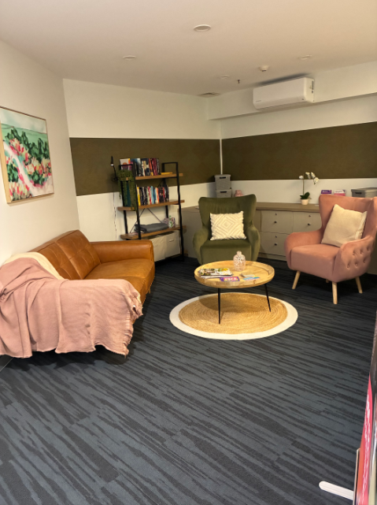
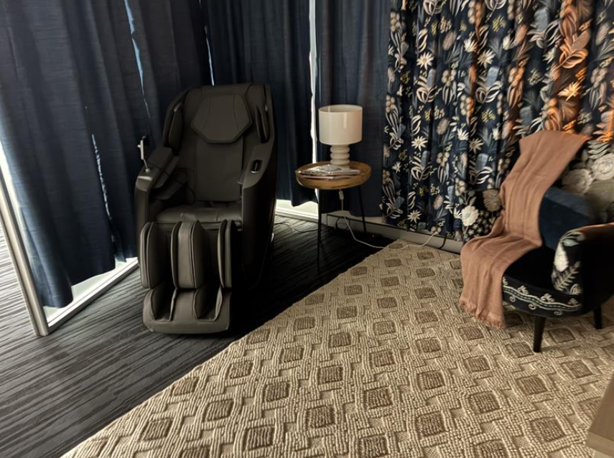
Cairns Carer Hub
Your Time. Your Community. Your Wellbeing
When: 9am – 4:30pm
Where: 141 – 143 Abbott St, Cairns
Notes:
New Carer Hub – 141-143 Abbott Street Cairns (open 9am – 4:30pm)
The Carer Hub is a safe and welcoming space designed for people who give so much of themselves in supporting loved ones. It’s a place where carers can rest, reconnect, recharge and be part of a community that truly understands your journey. Whether you join a fun activity, relax in the sensory room, explore our library, create art, access core services or simply have a cuppa and a yarn. The door is open

Slide 43
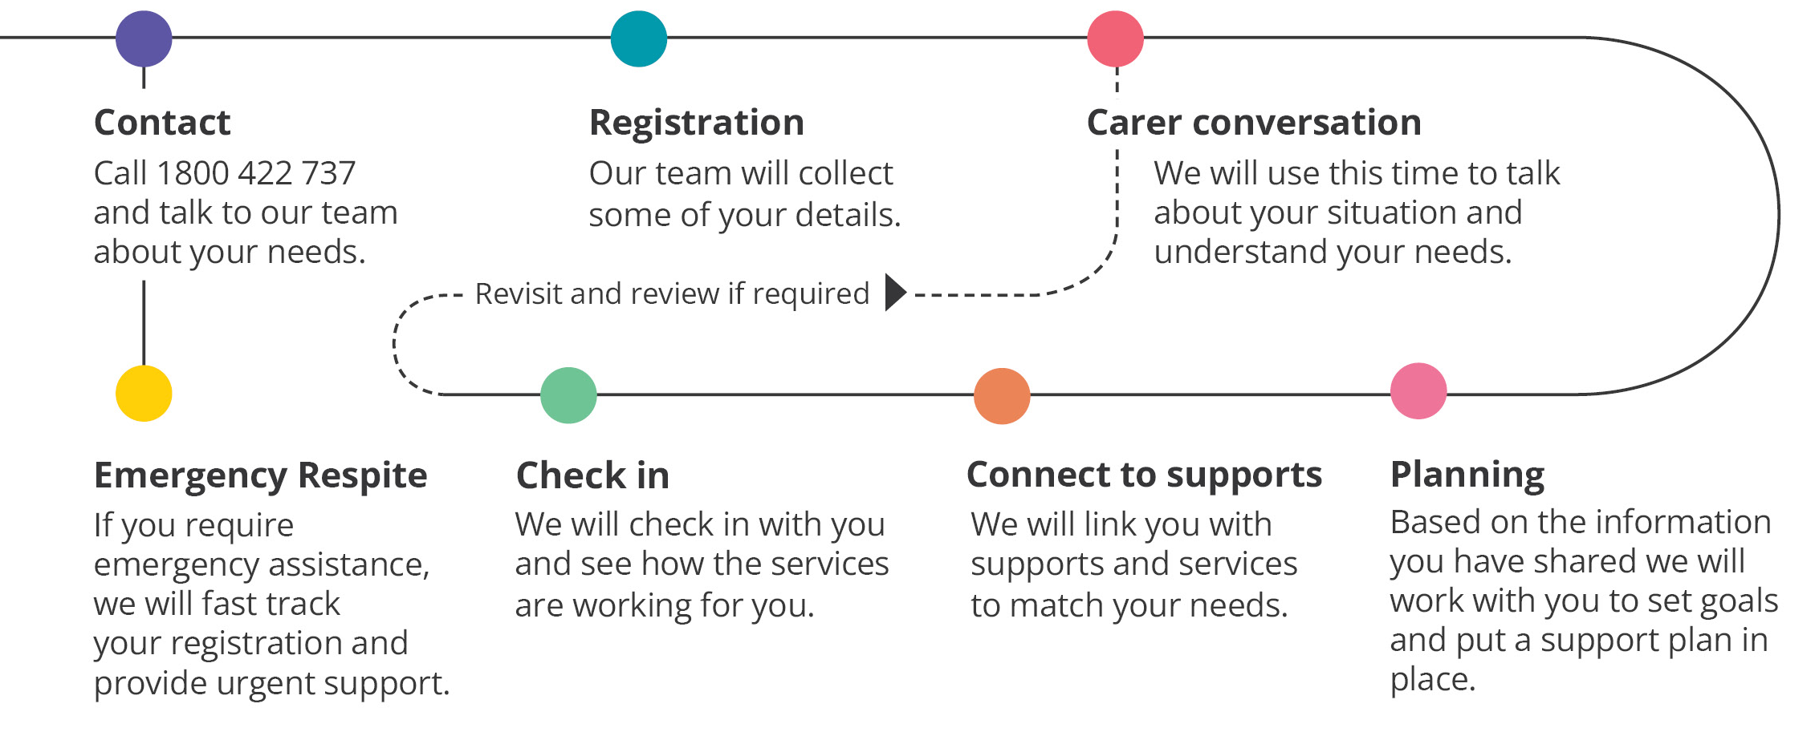
The Carer Gateway Journey
Notes:
Carers can register for Carer Gateway by calling 1800 422 737. After an initial assessment and planning session one of our Carer Support Workers will talk you through the range of supports available and put a personalised plan in place to match your individual needs.

Slide 44
Thank you
Name: Tania Konkoly
Community Engagement and Partnership Representative
Phone: 0421 540 407
Email: tkonkoly@wellways.org

Slide 46
Mental Health Carer Forum
Session 2
Questions and Answers

Slide 47
Mental Health Carer Forum
Lunch
Session 3 starts at 1:00pm

Slide 48
Mental Health Carer Forum
Session 3
Somatic movement activity

Slide 49

Mental Health Carer Forum
Sue Goodwin
Arafmi Lived Experience Advocacy Team Lead

Slide 50

Mental Health Carer Forum

Slide 51
Mental Health Carer Forum
Current:
1. Raising awareness of mental health carers
2. Raising awareness of supports and resources for mental health carers
3. Planning for what happens when carers can no longer care
4. Improving mental health carers’ experiences of hospital admission and
discharge processes
Additional:
5. Young carers
6. Mental health system reform

Slide 52
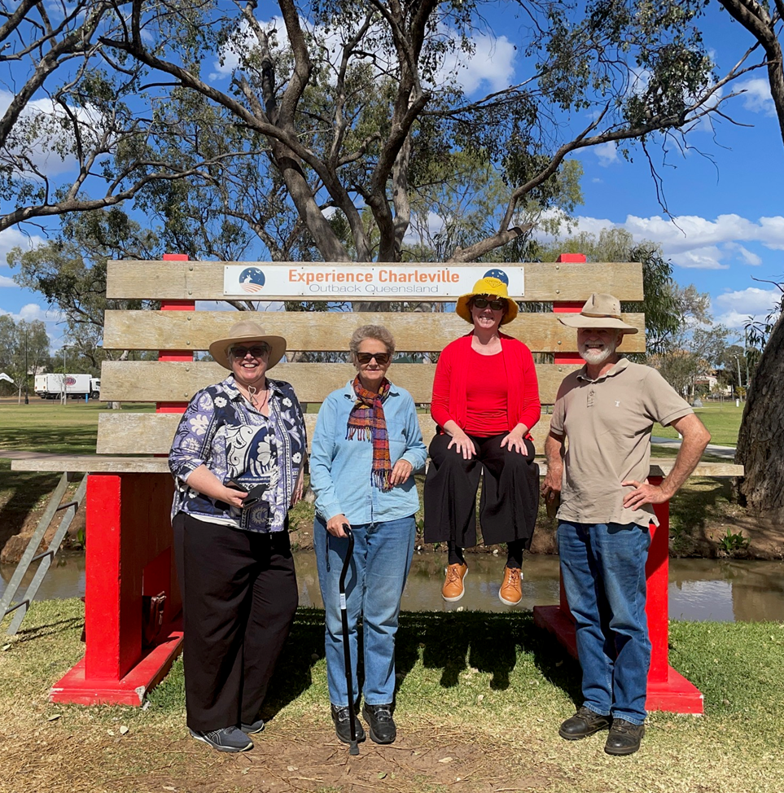
Mental Health Carer Forum
Additional challenges in rural areas:
1. Poor access to services and supports
2. Social isolation, stigma and privacy issues
3. Impacts of discharge processes
4. Cultural impacts for First Nations carers

Slide 53
Mental Health Carer Forum
Activity
What challenges or actions would you like to see addressed in the Cairns and Cape and Torres Regions?
In your table groups:
1. Discuss this question
2. Write down your ideas on the paper provided
3. Decide on your top 3 priorities

Slide 54
Mental Health Carer Forum
Session 3
Guided meditation

Slide 55
Mental Health Carer Forum
Wrap up
Survey, feedback & Lucky door prizes

Slide 56









Thanks to our exhibitors

Slide 57





Thanks to our donation supporters

Slide 58

Special thanks to

